Slide 1
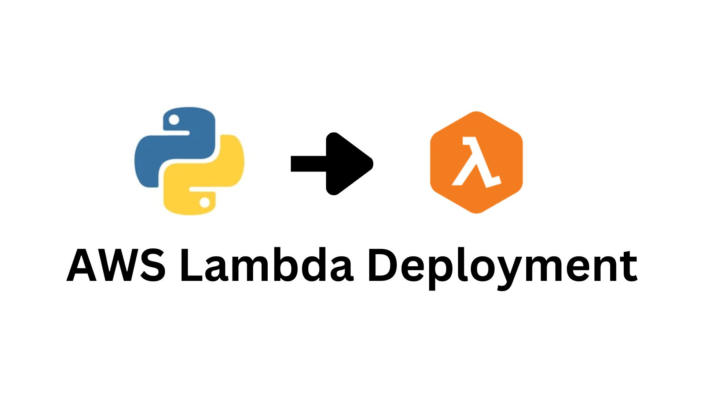

Slide 2
Scenario
You need to deploy a function written in python to Lambda.

Slide 3
GitHub Repository
https://github.com/AlphaTab435/Lambda-Deployment

Slide 4
Overview
Upload code to your remote repository
Create a code pipeline that fetches at source, Install packages and Update CloudFormation template file references at build, Create a change set and execute change set for cloudformation at deploy

Slide 5

Detailed explanation
Use readme file at https://github.com/AlphaTab435/Lambda-Deployment for better understanding
Or watch full explanation https://www.youtube.com/watch?v=6SSLBfOZOtQ&t=548s
at Gokce DB YouTube channel

Slide 6
Fast Track
Upload code to your remote repository
Use cloud already created cloud formation template file SAM_Backend_Template.yml to create code pipeline
You will be good to go might need to make some updates and will need some already created resources.

